Slide 1

CREDIT EDA CASE STUDY
AMJAD ALI
GARVITA
DA/BI IIIT-B DS_41

Slide 2
PROBLEM STATEMENT
Apply EDA in credit business for banking and financial services to understand the driving factors (or driver variables) behind loan default, i.e. the variables which are strong indicators of default and in turn to minimise the loss resulting from the rejection of good loans.

Slide 3
BUSINESS CONTEXT
Credit approval has a cost of assessment for a financial company apart from the various risks that arise during the lifetime of the credit.
Studying a customer’s credit history has a pivotal role in minimizing the loss or consequentially, maximizing the profit from the company’s point of view.
The analysis presented here attempts to ease this decision making for the company and to ensure that the business gets a bang for their buck!

Slide 4
ANALYSIS APPROACH
The “application_data.csv” file was imported and the missing values were analysed and the ways to impute the missing values were reported in the python file(as markdown text).
Handling of outliers and binning of continuous variables
were done
Imbalance percentage was checked and the data was
divided into subsets for Target 0 and Target 1.
Univariate and Bivariate analysis were performed for
continuous and categorical variables.
The data was then merged with the
“previous_application.csv” file and the univariate and bivariate analysis were done for both Target 0 and Target 1.

Slide 5
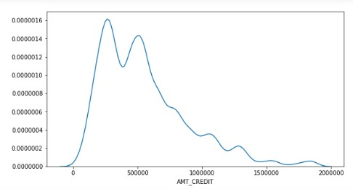
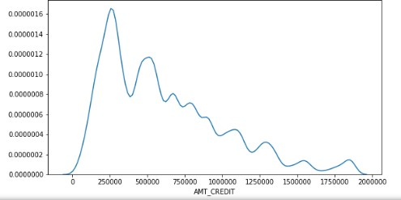
CUSTOMER PROFILING
UNIVARIATE ANALYSIS OF CONTINUOUS VARIABLE
TARGET 0 TARGET 1
From the "AMT_CREDIT" graph, it is visible that the people taking
a loan amount of 10lakhs or less are more likely to make default.

Slide 6
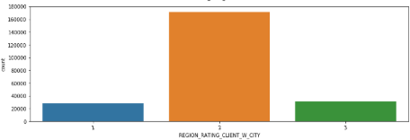
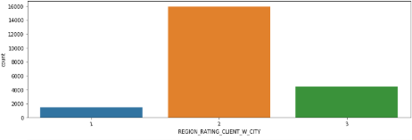
CUSTOMER PROFILING
UNIVARIATE ANALYSIS OF CATEGORICAL VARIABLE
TARGET 0
TARGET 1
From "REGION_RATING_CLIENT_W_CITY" graph it is visible that people belonging to the Tier-3 city are most likely to make a default.

Slide 7
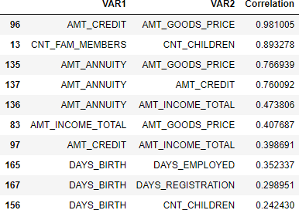
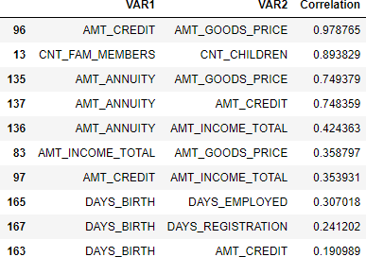
CUSTOMER PROFILING
BIVARIATE ANALYSIS OF CONTINUOUS-CONTINUOUS
TARGET 0 TARGET 1
The top 9 correlation chart of defaulters and non-defaulters are almost same both with respect to the type of variables and correlation coefficient which proves that the variables are independent of defaulting. If we inspect more into the correlation aspect, the top two variables represent very strong correlations and an increase in one variable would show similar increase in the other and vice versa. The next three variables are mildly correlated and can be considered depending on the context. Values less than 0.5 are not to be considered for correlation anyhow. Only the 10th combination is different.

Slide 8
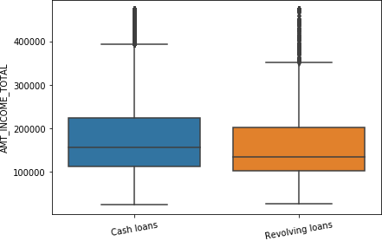
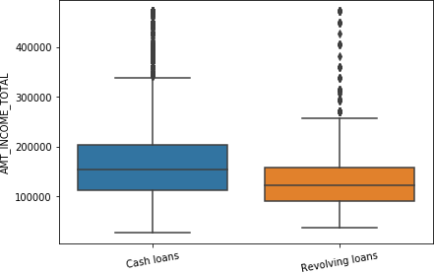
CUSTOMER PROFILING
BIVARIATE ANALYSIS OF CONTINUOUS-CATEGORICAL VARIABLE
TARGET 0 TARGET 1
The box plot trends are different for defaulters and non-defaulters. For non defaulters, the box plot inter quartile range show a greater variability, and right skewed, which essentially means that people earning greater than the median salary are more in no. as compared to people earning lesser than the median salary. For defaulters the inter quartile region seems to be balanced. The logic seems to be right as per us since there are more people who earn more than the median salary. The chances of defaulting goes down.

Slide 9
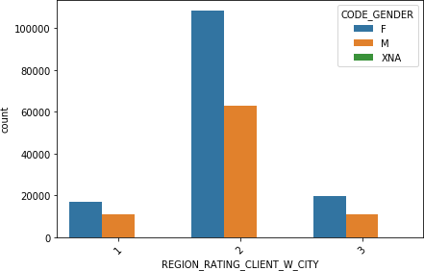
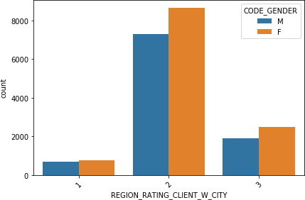
CUSTOMER PROFILING
BIVARIATE ANALYSIS OF CATEGORICAL-CATEGORICAL VARIABLE
TARGET 0 TARGET 1
In all the Rated cities, female are less likely to default, and if seen Tier-2 city females are not likely to default at all.

Slide 10
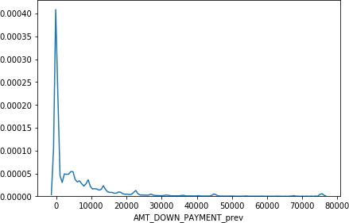
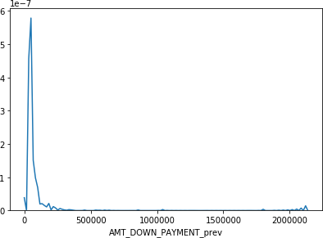
CUSTOMER PROFILING
UNIVARIATE ANALYSIS OF CONTINUOUS VARIABLE OF MERGED DATA
MERGED TARGET 0 MERGED TARGET 1
From "AMT_DOWN_PAYMENT_prev" graph it is visible that people making more down payment in the previous applications are likely to default.

Slide 11
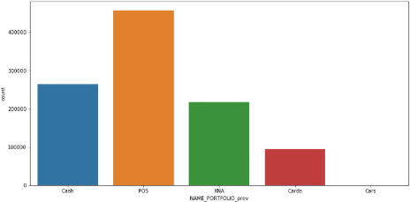
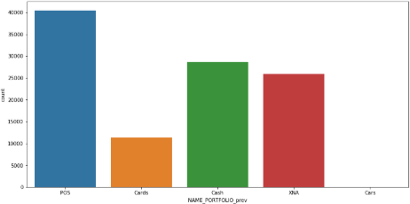
CUSTOMER PROFILING
UNIVARIATE ANALYSIS OF CONTINUOUS VARIABLE OF MERGED DATA
MERGED TARGET 0
MERGED TARGET 1
From "NAME_PORTFOLIO_prev" graph, it is visible that the previous application for cash and cards is more for the defaulters.

Slide 12
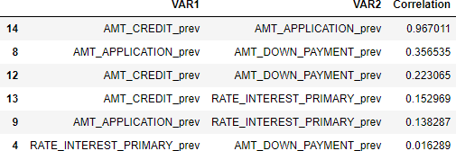
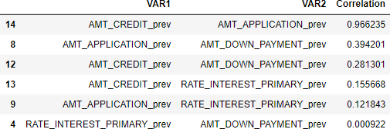
CUSTOMER PROFILING
BIVARIATE ANALYSIS OF CONTINUOUS-CONTINUOUS VARIABLE OF MERGED DATA
MERGED TARGET 0 MERGED TARGET 1
Comparing the two tables, it can be seen that for both defaulters and non defaulters the correlation between the amount asked in the application by the customer and the amount sanctioned by the credit agency is the highest, which means that the change in one variable will highly affect the change in the other. All others in the table can be neglected as the correlation value is very low.

Slide 13
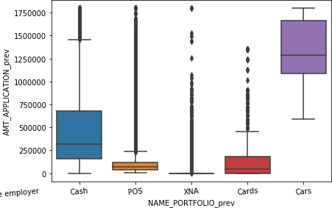
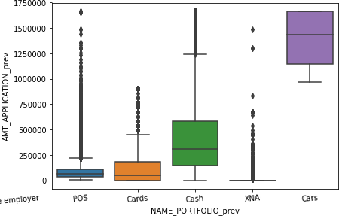
CUSTOMER PROFILING
BIVARIATE ANALYSIS OF CONTINUOUS-CATEGORICAL VARIABLE OF MERGED DATA
MERGED TARGET 0 MERGED TARGET 1
For all the categories of portfolio it is same in both the cases except for the portfolio of car category. Defaulters having cars in the portfolio category have a higher median value and minimum value and it is also visible that they have applied for loan amount lesser than the median value in the application.

Slide 14
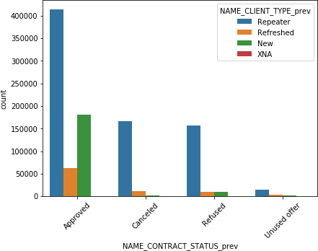
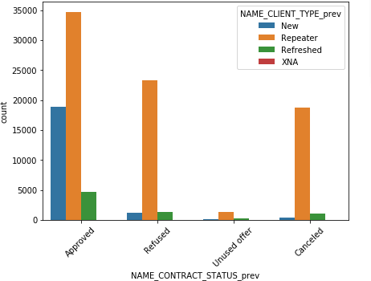
CUSTOMER PROFILING
BIVARIATE ANALYSIS OF CATEGORICAL-CATEGORICAL VARIABLE OF MERGED DATA
MERGED TARGET 0
MERGED TARGET 1
People whose previous application have been 'Refused' or 'Cancelled' and were Repeaters are more likely to default. People whose previous application have been 'Approved' and were New customers are more likely to default.

Slide 15
MAJOR RECOMMENDATIONS
While extending or cancelling a loan application, credit history of the applicant is of utmost importance. Even if a credit application for a customer has been approved in the past, a customer may default. So the customer demographics play a prime role here.
To avoid a default, major recommendations for the business are to verify the following types of customers:
Male customers in Tier 3 cities and applying for loans of less than 10 lakhs
Customers making more down payment in the previous loan applications
Customers who applied for cards in the previous applications
Customers who were ‘Repeaters’ and were ‘Refused’ in
previous applications

Slide 16
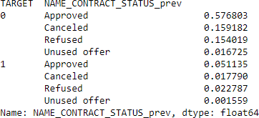
INFERENCE
15.4% of the sample who were refused loans previously turned out to be Non-Defaulters, where as 5.1% of the sample who were approved loans previously turned out to be defaulters.
This is the loss to the financial company that can result from refusal of
good loans (15.4%) and approval of bad loans(5.1%). So as a company our objective should be to reduce these losses as much as possible.

Slide 17
THANK YOU!

